Slide 1

Note: The data and information in this document is reflective of a hypothetical situation and client. This document is to be used for KPMG Virtual Internship purposes only.
Sprocket Central Pty Ltd
Data analytics approach
[Division Name] - [Engagement Manager], [Senior Consultant], [Mathonsi MM]

Slide 2
Note: The data and information in this document is reflective of a hypothetical situation and client. This document is to be used for KPMG Virtual Internship purposes only.
Agenda
Introduction
Data Exploration
Model Development
Interpretation

Slide 3
Note: The data and information in this document is reflective of a hypothetical situation and client. This document is to be used for KPMG Virtual Internship purposes only.
Introduction
We can glean helpful customer insights from the data given by Sprocket Central Pty Ltd that may help target marketing resource allocation more effectively.
The model or relationships that were used to link the datasets are also described in this converse.
The power bi dashboard developed offers better information based on performance by putting an emphasis on high value clients.

Slide 4
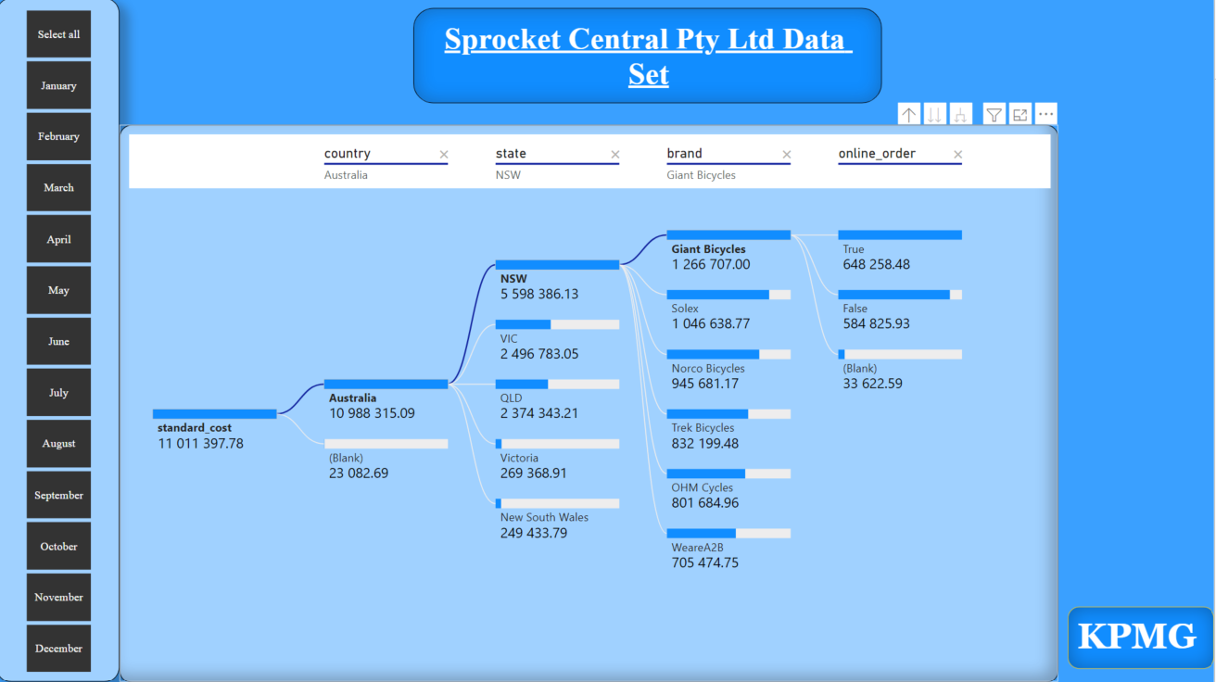
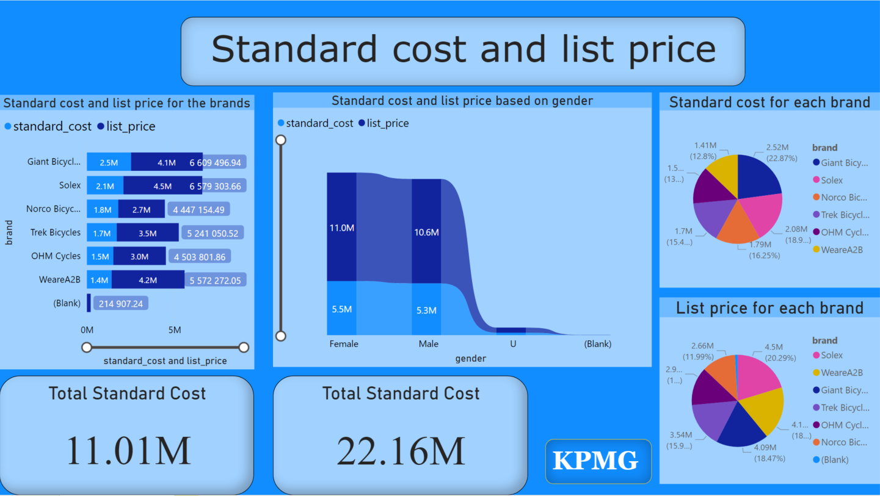
Note: The data and information in this document is reflective of a hypothetical situation and client. This document is to be used for KPMG Virtual Internship purposes only.
Data Exploration
By using the Power BI tool to explore the data, we gain some insight into how the business sets prices based on a variety of factors, including job, title, gender, state, and others.
By exploring the data, we are able to find some vital insights such as:
Which state should the company produce more of its product and their names according to demand of the product based on the data.
Which Job description and Job category should the company be targeting to as the primary customers.
Place any supporting images, graphs, data or extra text here.

Slide 5
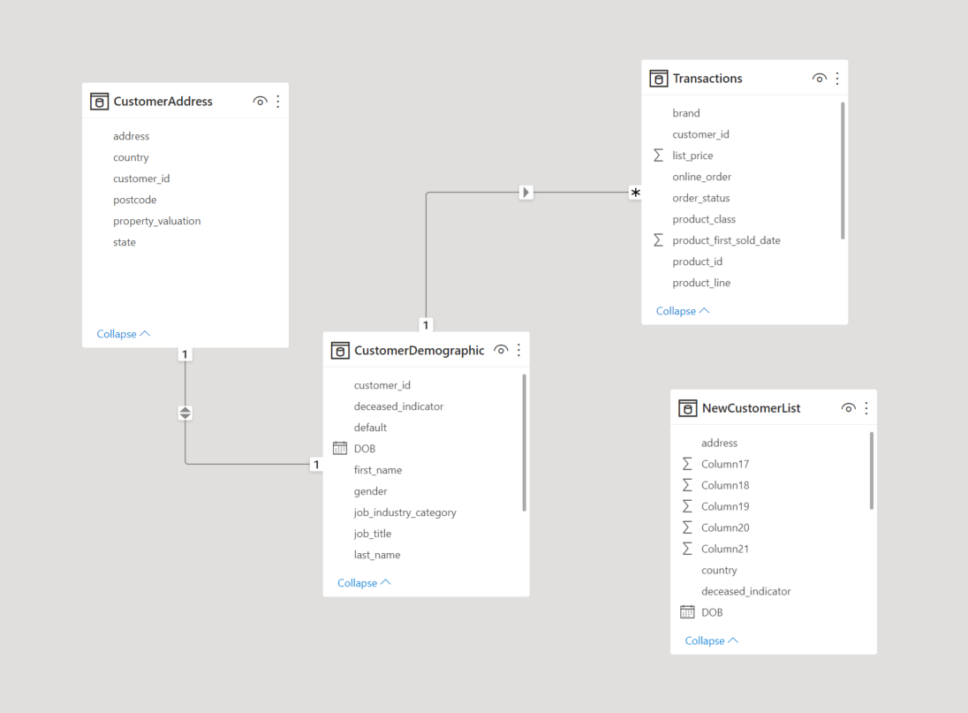
Note: The data and information in this document is reflective of a hypothetical situation and client. This document is to be used for KPMG Virtual Internship purposes only.
Model Development
Connecting data from various data sources or tables while utilizing some connections and relationships. Here we create the power BI data model within the Sprocket Central Pty Ltd data.
.
Step 1: Creating Model Relationships
Step 2: Configuring Tables
Step 3: Calculate And Measure Data
Create Table
Create Column
Step 4: Create Visualization
Place any supporting images, graphs, data or extra text here.

Slide 6
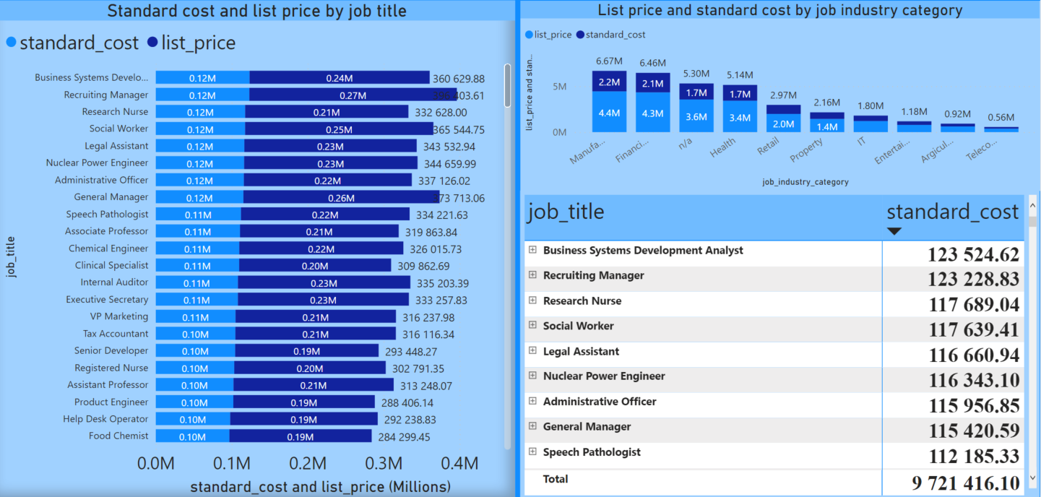
Note: The data and information in this document is reflective of a hypothetical situation and client. This document is to be used for KPMG Virtual Internship purposes only.
Interpretation
The dashboard provides significant insights based on the customers the company should pay attention to such as:
They have to provide more “Solex” bikes as they are bought more compared to the other products.
The NSW state offers greater profits than the other states, so the business should look into the factors that led to the high sales in order to better the other states.
The Business System Development Analysts prefer the Giant Bicycles as they are the occupants that supports the company.
More interpretations and insights are presented in the dashboard.

Slide 7
Note: The data and information in this document is reflective of a hypothetical situation and client. This document is to be used for KPMG Virtual Internship purposes only.
Appendix
By Mathonsi MM
Email: mphikelelimm@gmail.com

Slide 8
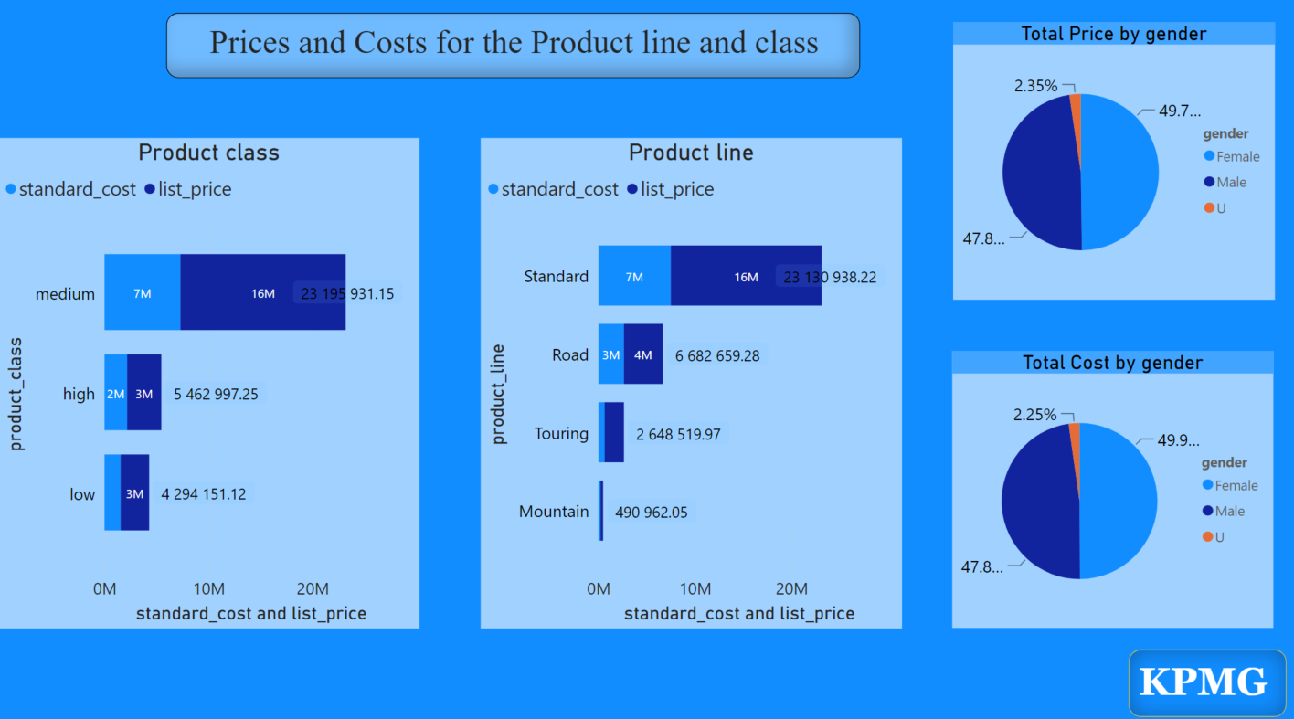
Note: The data and information in this document is reflective of a hypothetical situation and client. This document is to be used for KPMG Virtual Internship purposes only.
Appendix
We can extract more insights based on gender and the product lines and class

